Slide 1
Detect Simpson’s Paradox
D
S
P

Slide 2
Contents
Upload File
Data Analysis
Auto Detect
Interactive with Scatterplot
Interactive with Table

Slide 3
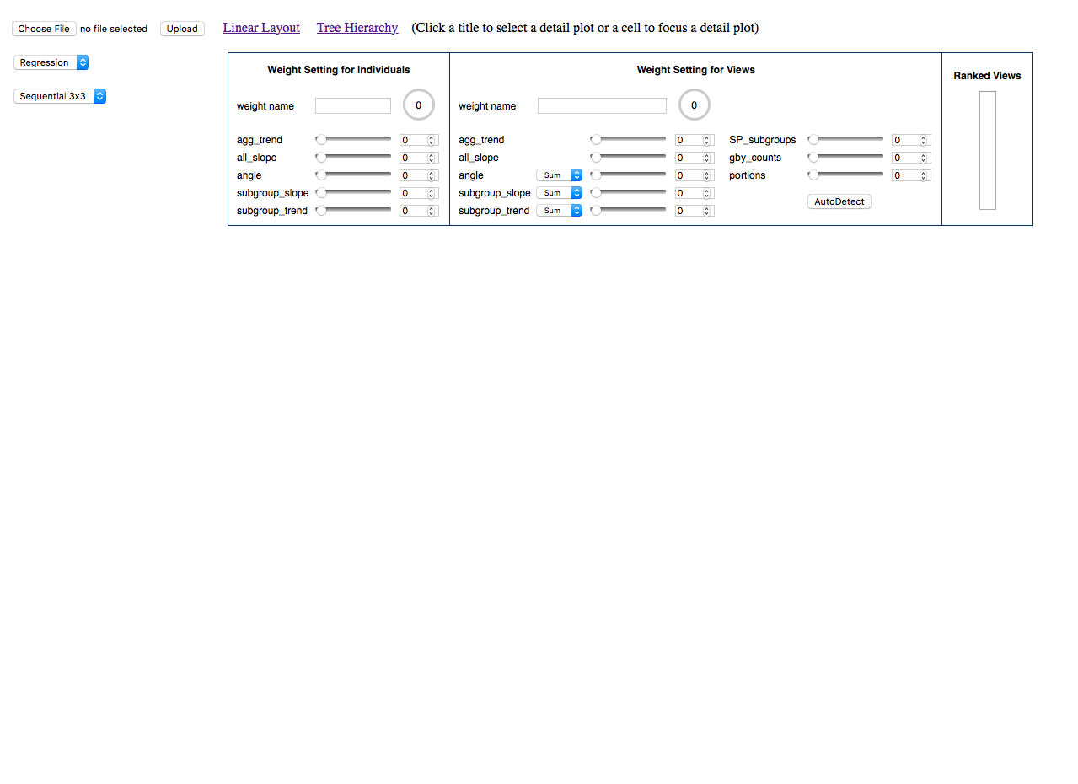
Upload File
1
4
Click “Choose File”: select a data file from your local disk.
Select type: regression/rate
Adjust weights: set weights for individual records and views. You should set the weights to 100% totally and name the setting.
Click “Upload”: upload the data file to the web application
2
3

Slide 4
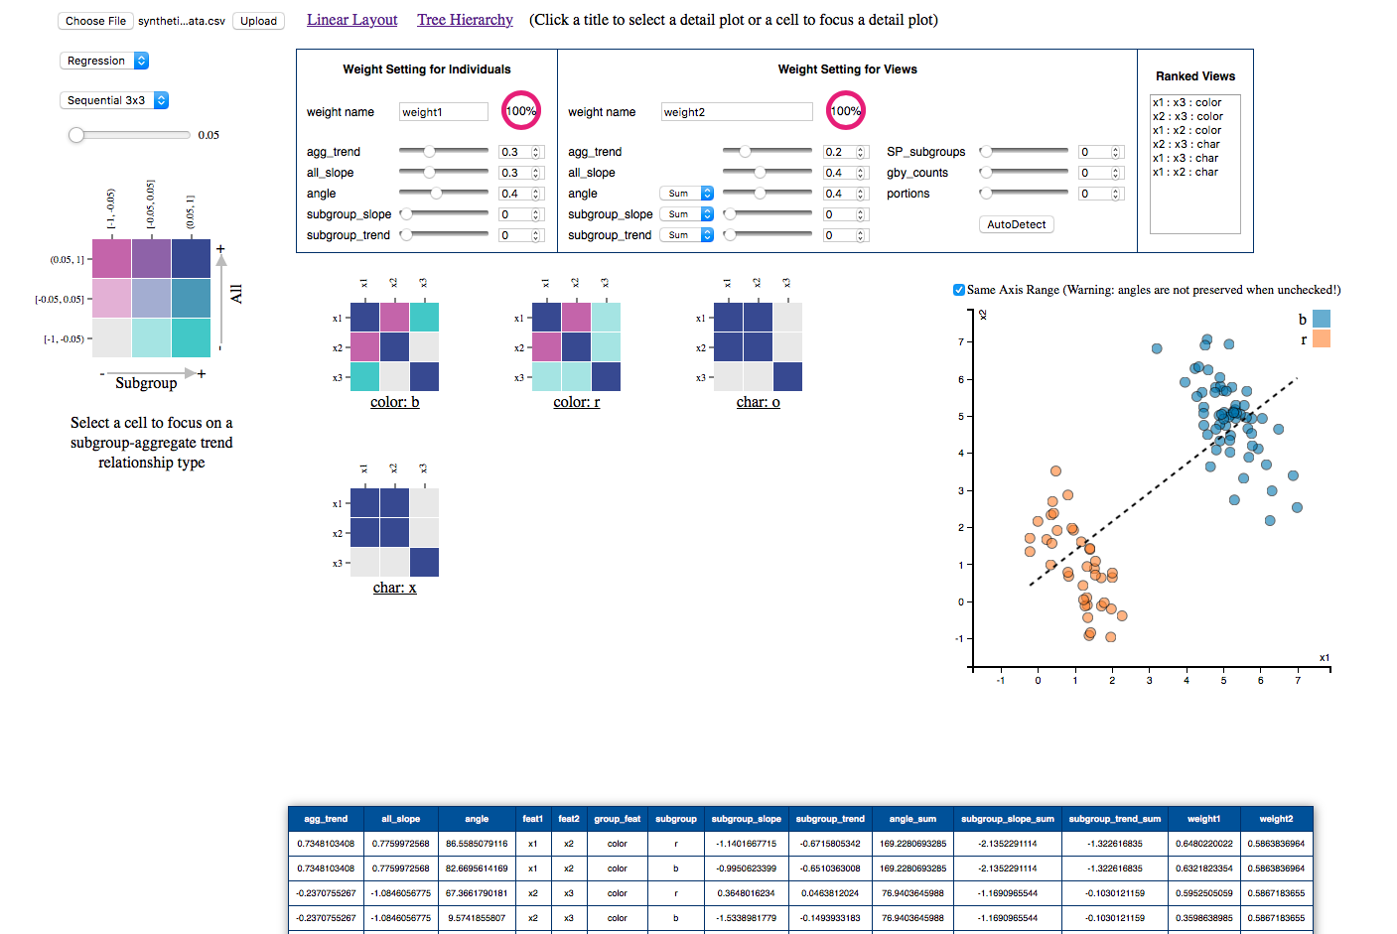
Data Analysis
1
Click “Linear Layout”: bivariate matrix heatmaps will shown.
Select bivariate color scheme for bivariate matrix heatmaps
Click a cell of the bivariate color legend to filter the unmatched colored cells in A. Double Click release the filtering.
Click a cell of Bivariate matrix heatmaps to show the detail in B and C.
2
3
4
A
C
B

Slide 5
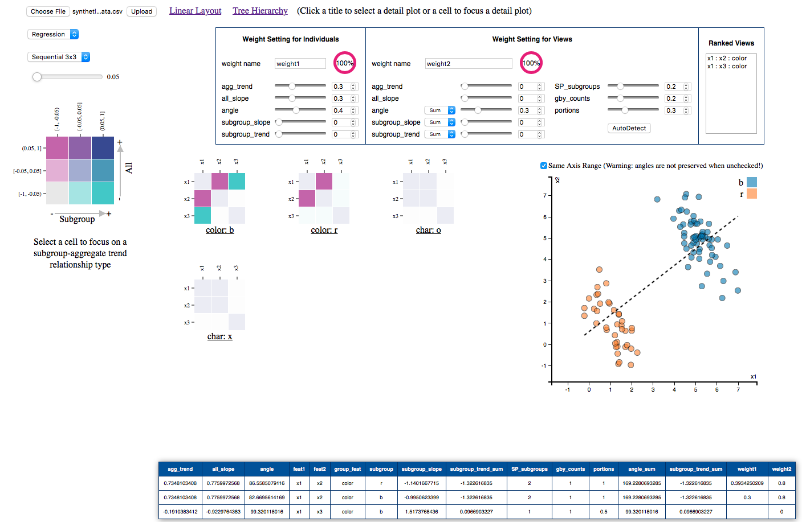
Auto Detect
Adjust the threshold of correlation.
Select SP-related weights
Click “AutoDetect”: detect the SP automatically and rank the views.
Click a view in ranked views box to filter irrelevant components in A and B.
2
1
4
3
A
C
B

Slide 6
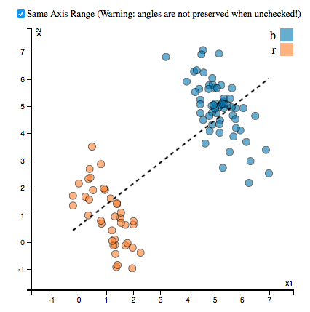
Interact with Scatterplot
Click “Same Axis Range”: use the same range for both axes. Otherwise, axes’ ranges use each corresponding attributes’ data range.
1

Slide 7
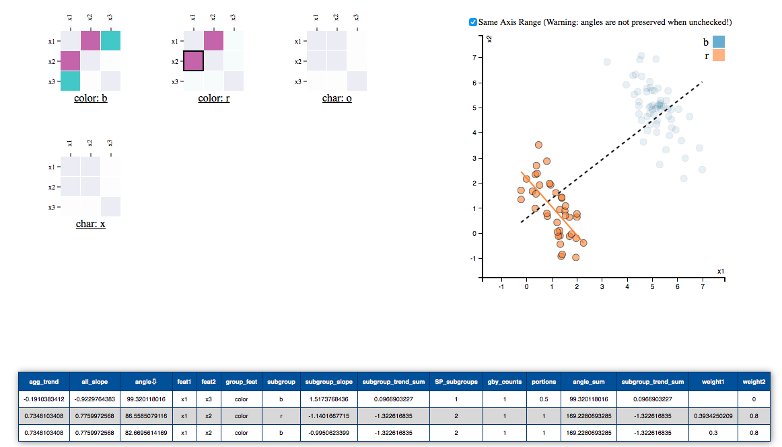
Interact with Table
Click the header to sort the table.
Click a row to highlight the corresponding information in A and C.
A
C
1
B
2

